Slide 1
UMAP: Uniform Manifold Approximation and Projection for Dimension Reduction
GwangWoo Kim
July 1, 2021

Slide 2
Contents
1. Introduction
2. Theoretical Foundations for UMAP
3. A Computational View of UMAP
4. Implementation and Hyper-parameters
5. Practical Efficacy
6. Weakness

Slide 3
1. Introduction
What is dimension reduction?

Slide 4
1. Introduction
Find the “latent” feature in your data

Slide 5
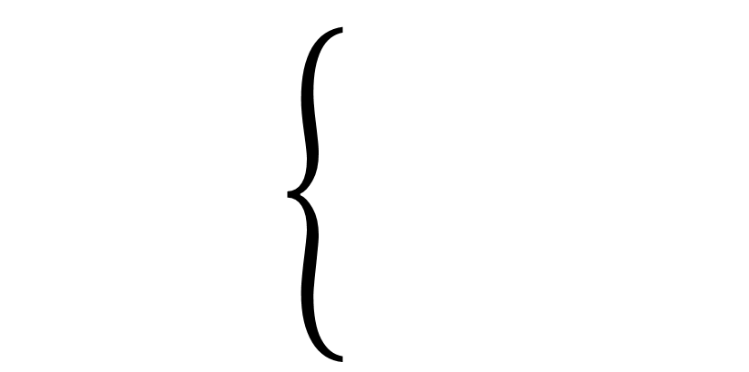
1. Introduction
Matrix Factorization
Principle Component Analysis, Linear Autoencoder, Latent Dirichlet Allocation, Non-negative matrix factorization, Generalized Low Rank Models, GloVe, Word2Vec.
Dimension Reduction
Neighbor Graphs
Laplacian Eigenmaps, Hessian Eigenmaps, Local Tangent Space Alignment, JSE, Isomap, Locally Linear Embedding , t-SEN, UMAP.

Slide 6
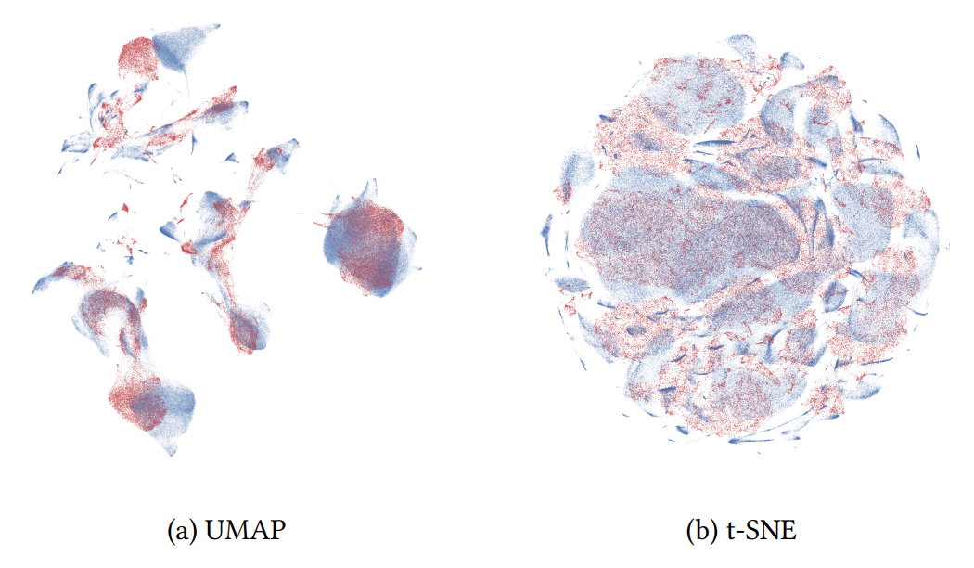
1. Introduction

Slide 7
2. Theoretical Foundations for UMAP
0-simplex
1-simplex
2-simplex
3-simplex

Slide 8
2. Theoretical Foundations for UMAP
0-simplex
1-simplex
2-simplex
3-simplex
Simplicial Complex

Slide 9
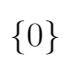
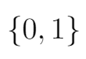
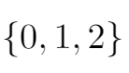
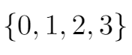
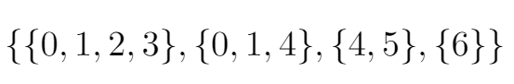
2. Theoretical Foundations for UMAP
0-simplex
1-simplex
2-simplex
3-simplex
Simplicial Complex

Slide 10
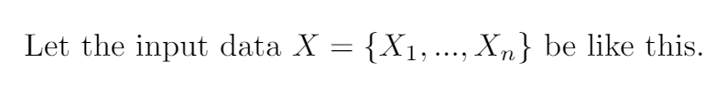
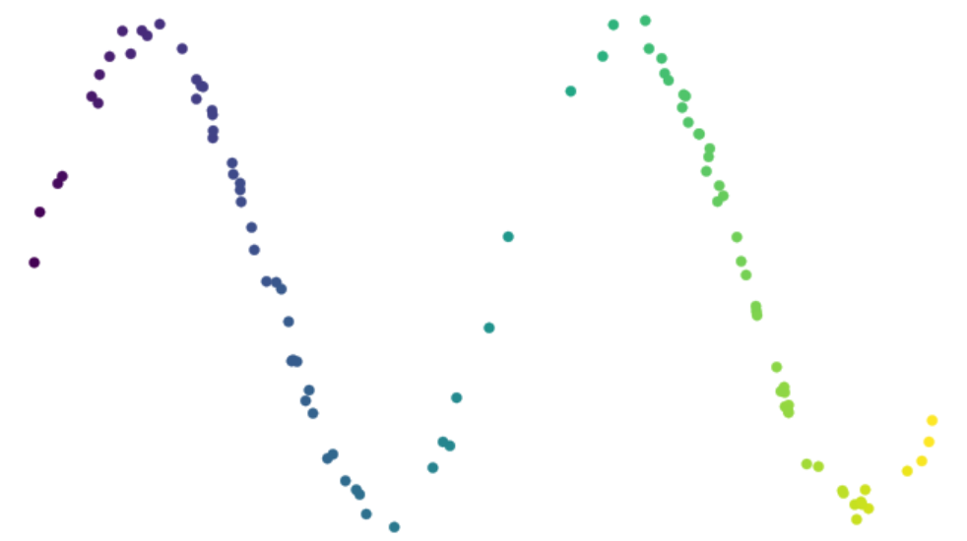
2. Theoretical Foundations for UMAP

Slide 11
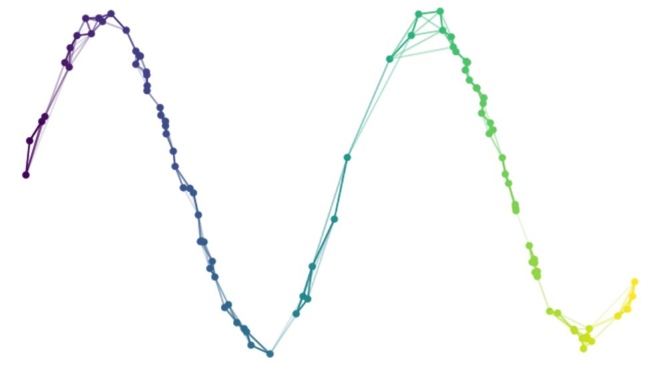
2. Theoretical Foundations for UMAP

Slide 12
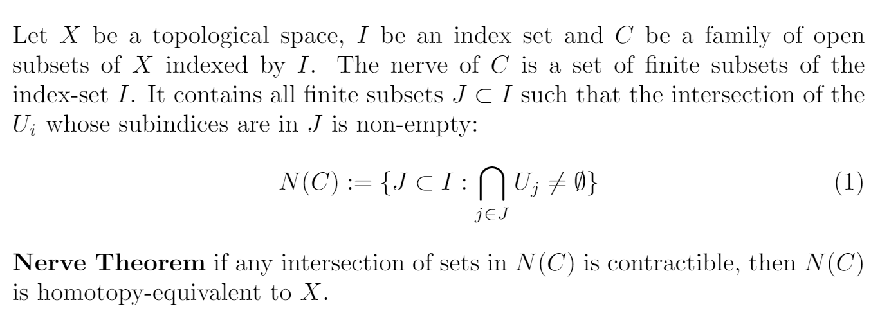
2. Theoretical Foundations for UMAP

Slide 13
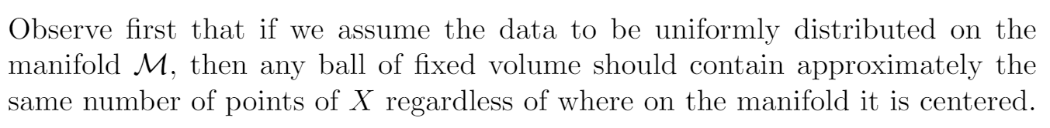
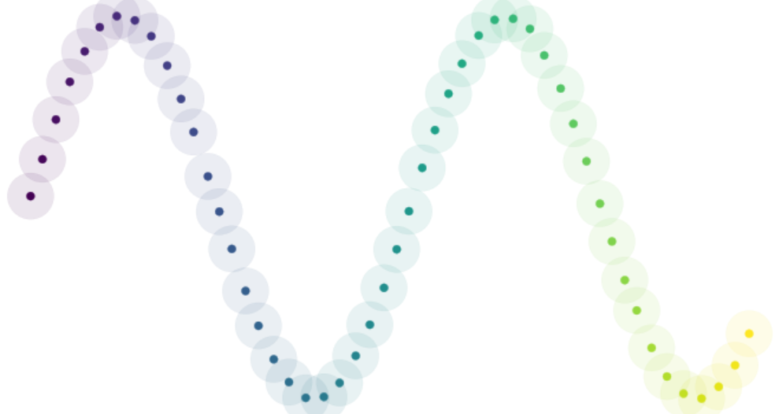
2. Theoretical Foundations for UMAP

Slide 14
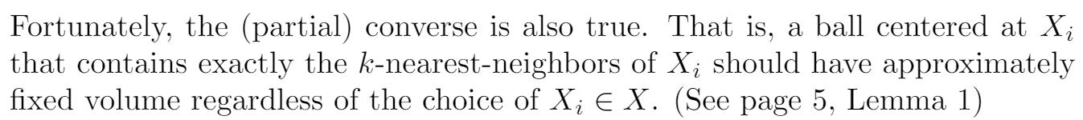
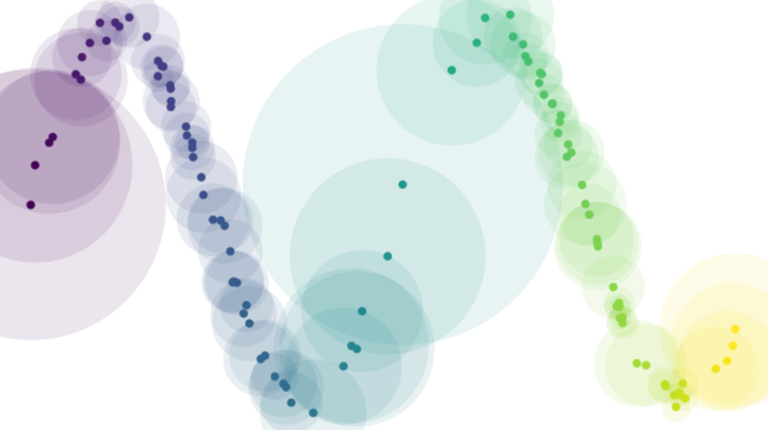
2. Theoretical Foundations for UMAP

Slide 15
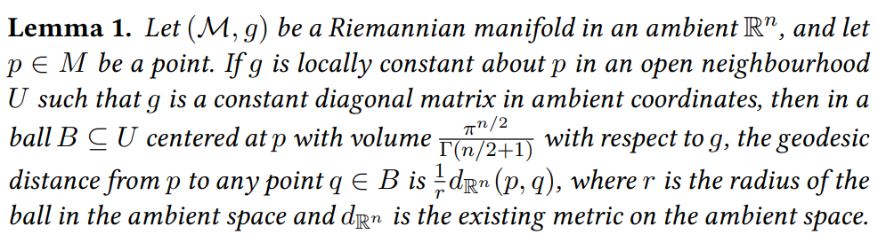
2. Theoretical Foundations for UMAP

Slide 16
2. Theoretical Foundations for UMAP
The cost is that we now have an independent notion of distance for each and every point in the data, and these notions of distance may not be compatible.

Slide 17
2. Theoretical Foundations for UMAP

Slide 18
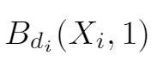
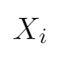
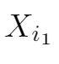
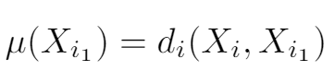
2. Theoretical Foundations for UMAP
Warning

Slide 19
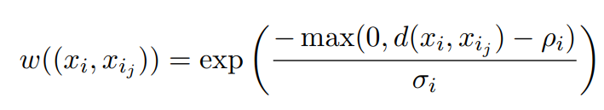
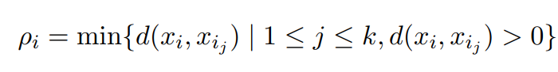
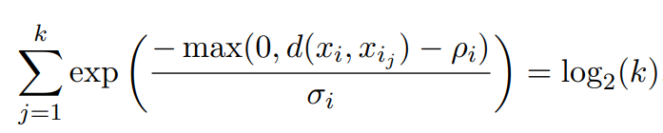
2. Theoretical Foundations for UMAP

Slide 20
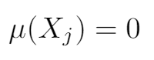
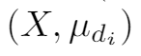
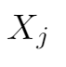
2. Theoretical Foundations for UMAP
A fuzzy set with the membership function induced by (local) metric of

Slide 21
2. Theoretical Foundations for UMAP
The union provides the means to merge together the different metric spaces.
2. It gives a practical computational perspective. (See later)
3. We have created a strong theoretical background.

Slide 22
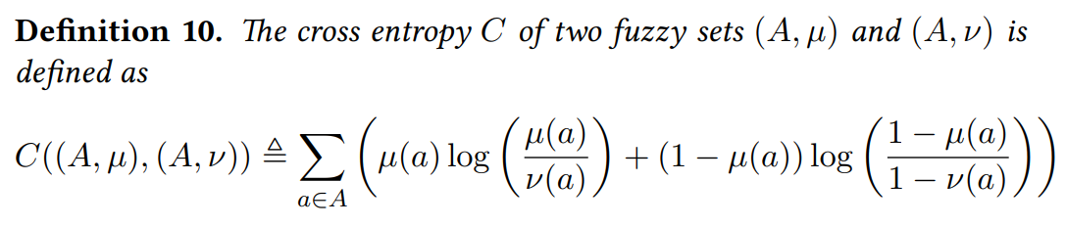
2. Theoretical Foundations for UMAP

Slide 23
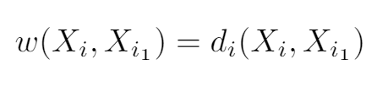
3. A Computational View of UMAP

Slide 24
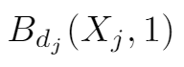
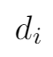
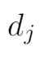
3. A Computational View of UMAP

Slide 25
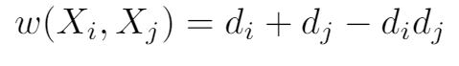
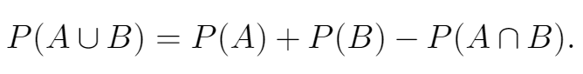
3. A Computational View of UMAP
We want to incorporate two directed edges into one undirected edge that reflects two weights.
The motivation follows from

Slide 26
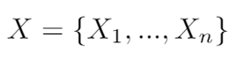
3. A Computational View of UMAP

Slide 27
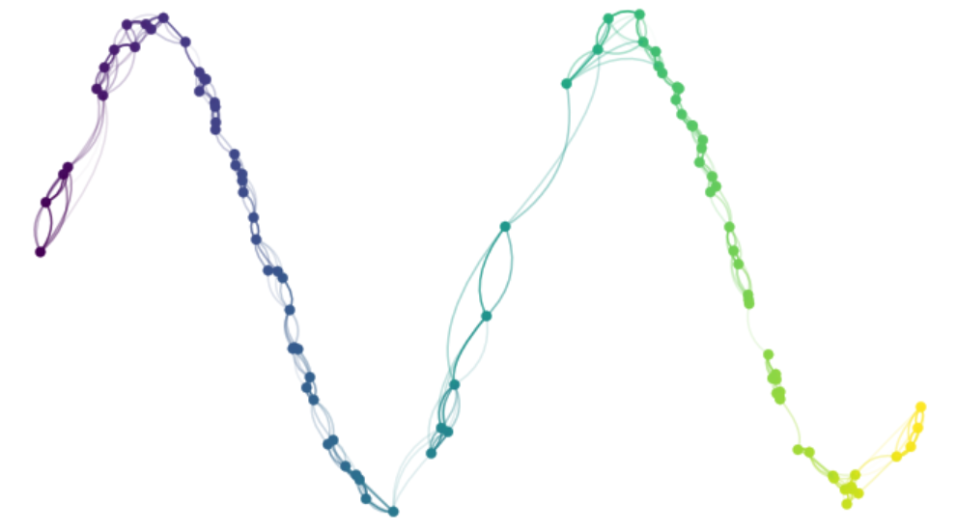
3. A Computational View of UMAP

Slide 28

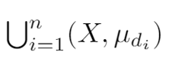
3. A Computational View of UMAP

Slide 29
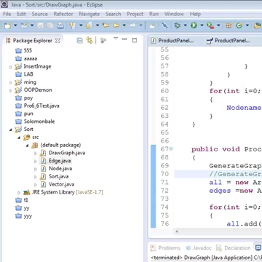
3. A Computational View of UMAP
Force directed graph layout algorithm

Slide 30
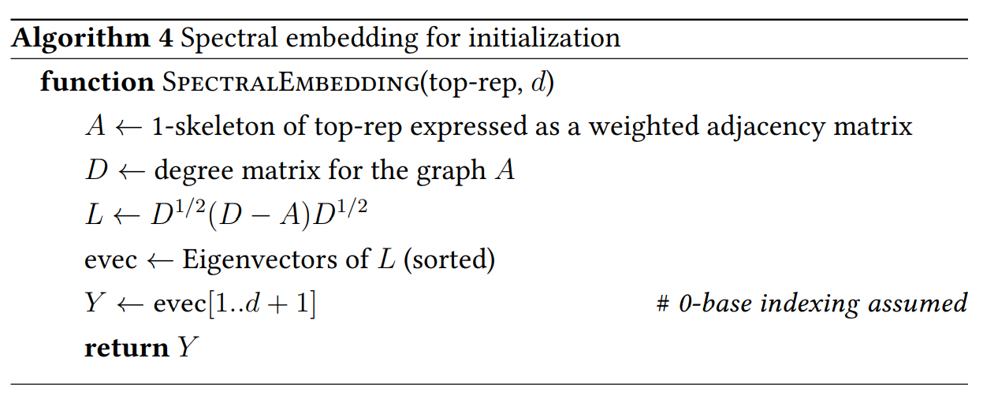
3. A Computational View of UMAP

Slide 31
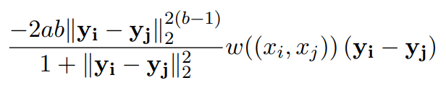
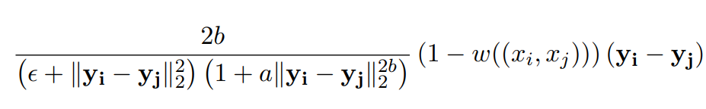
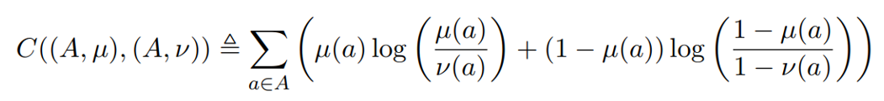
3. A Computational View of UMAP
Attractive force:
Repulsive force:

Slide 32
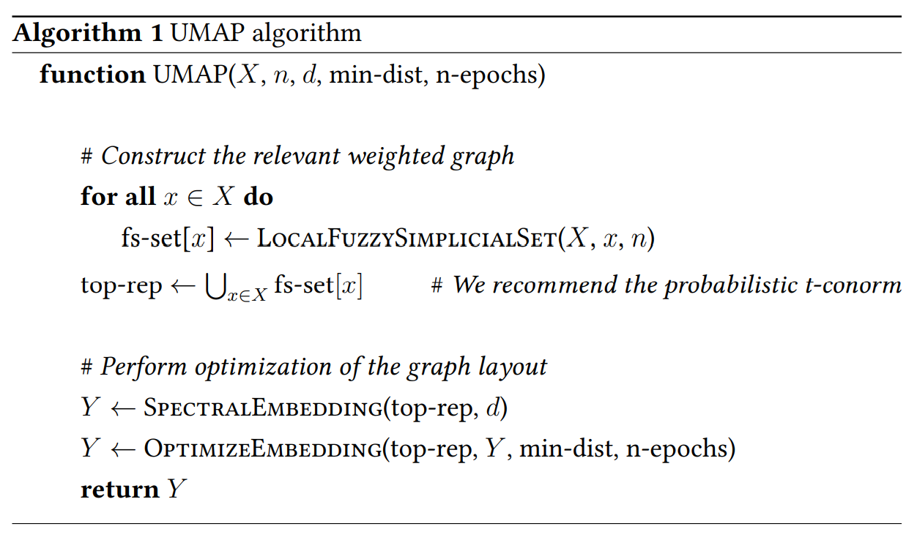
4. Implementation

Slide 33
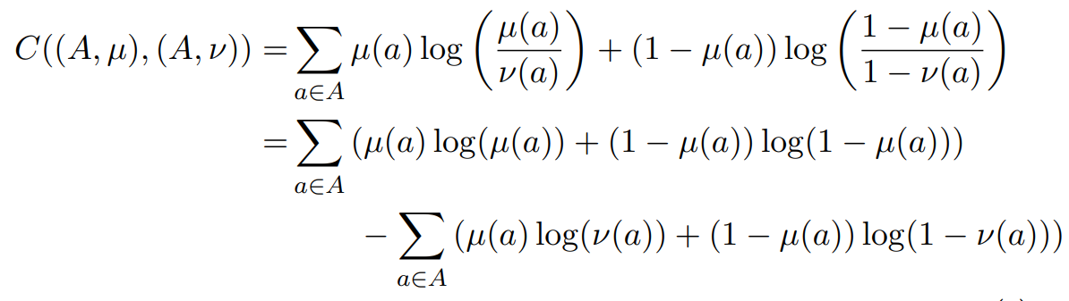
4. Implementation

Slide 34
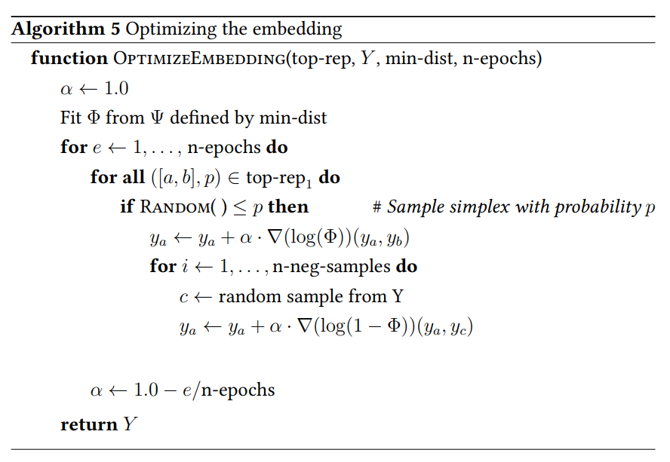
4. Implementation

Slide 35
4. Implementation

Slide 36
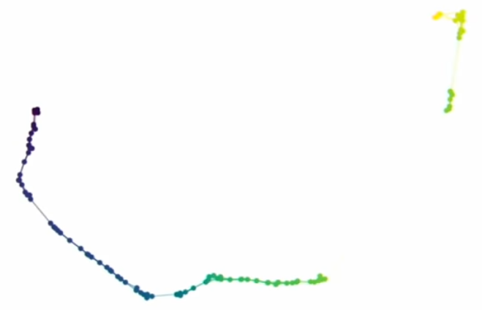
4. Implementation

Slide 37
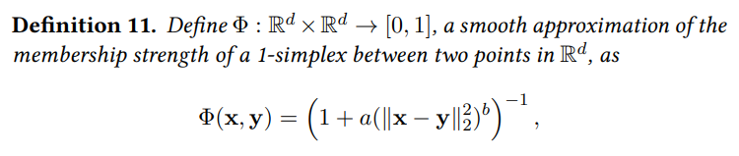
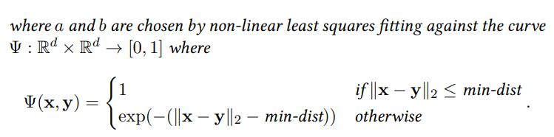
4. Implementation

Slide 38
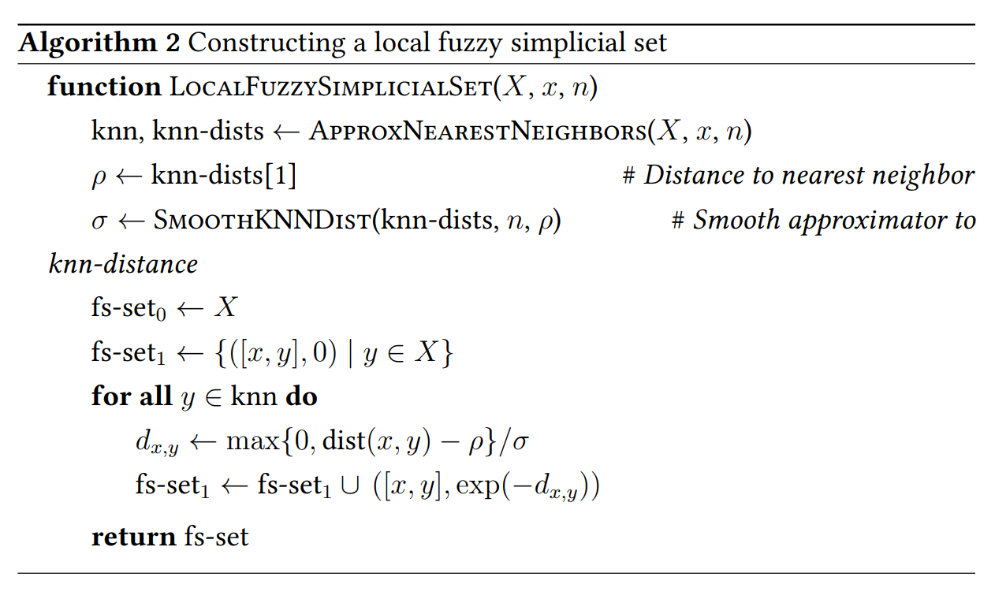
4. Implementation

Slide 39
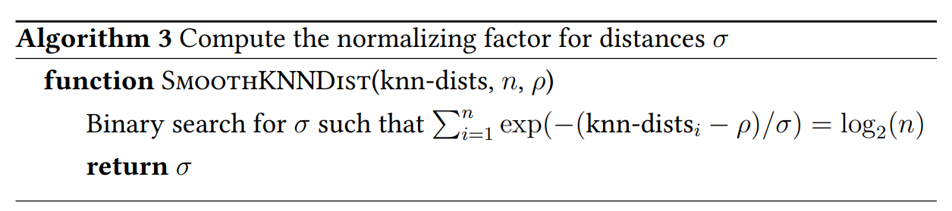
4. Implementation

Slide 40
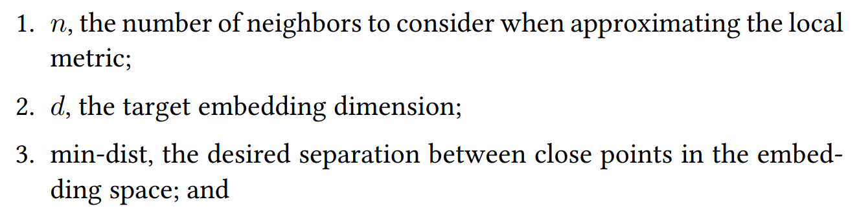

4. Hyper-parameters

Slide 41


4. Hyper-parameters
N_neighbor=5
N_neighbor=20
N_neighbor=80
N_neighbor=320
Smaller values will ensure detailed manifold structure is accurately captured, while larger values will capture large scale manifold structures.

Slide 42
4. Hyper-parameters
Min_dist=0.0125
Min_dist=0.05
Min_dist=0.2
Min_dist=0.8
Low values on min-dist will result in potentially densely packed regions, but will likely more faithfully represent the manifold structure. Increasing the value of min-dist will force the embedding to spread points out more,

Slide 43


5. Practical Efficacy
Fashion MNIST
MNIST
UMAP
t-SNE
LargeVis
Laplasian Eigenmaps
PCA

Slide 44

5. Practical Efficacy

Slide 45


Slide 46

5. Practical Efficacy

Slide 47
5. Practical Efficacy
 | Pen Digits (1797x64) | COIL20 (1440x16384) | COIL100 (7200x4952) | scRNA (21086x1000) | Shuttle (58000x9) | MNIST (70000x784) | F-MNIST (70000x784) | Flow (100000x17) | Google News (200000x300)
UMAP | 9s | 12s | 85s | 28s | 94s | 87s | 65s | 102s | 361s
Fit-SNE | 48s | 75s | 2681s | 131s | 108s | 292s | 278s | 164s | 652s
t-SNE | 17s | 22s | 810s | 258s | 714s | 1450s | 934s | 1135s | 16906s
LargeVis | 20s | 82s | 3197s | 377s | 615s | 1298s | 1173s | 1127s | 5392s
Eigenmaps | 2s | 47s | 3268s | 470s | 133s | 40709s | 6356s | 30654s | -
Isomap | 2s | 58s | 3210s | 923s | - | - | - | - | -

Slide 48

5. Practical Efficacy

Slide 49

5. Practical Efficacy

Slide 50

5. Practical Efficacy

Slide 51
6. Weakness
UMAP lacks the strong interpretability of PCA and related techniques such a NMF.
2. While we believe that UMAP can capture more global structure than these other techniques, it remains true that if global structure is of primary interest then UMAP may not be the best choice for dimension reduction.
3. The use of approximate nearest neighbor algorithms, and the negative sampling used in optimization, can result in suboptimal embeddings for small (less than 500 samples) dataset sizes.

Slide 52
Thank you for your attention!

Slide 53
References
McInnes, Leland, John Healy, and James Melville. "Umap: Uniform manifold approximation and projection for dimension reduction." arXiv preprint arXiv:1802.03426 (2018).
https://umap-learn.readthedocs.io/en/latest/how_umap_works.html
https://www.youtube.com/watch?v=nq6iPZVUxZU

